Slide 1
BANK CHURN ANALYSIS
Presented by : Vinod A. Korachgaon Batch : DA172S17+ML22S2 Course : Supervised Machine Learning Course Ending Project Client : Komilla Bhatia Date : 21-03-2024

Slide 2
Problem Statement:
Customers are quitting the Bank
Objective :
Predict whether customers will leave the bank in the future using machine learning, keeping the goal of reducing churn.
Description of the Dataset :
The dataset has 10000 rows and 13 columns . It provides information on Customers Surname, credit score , Geography , Gender, Age ,Tenure, Balance , Number of products , Credit card status , activity status , Salary , Attrition Status

Slide 3
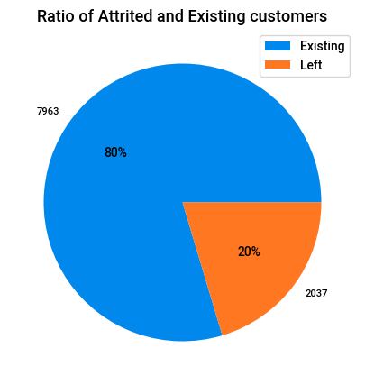
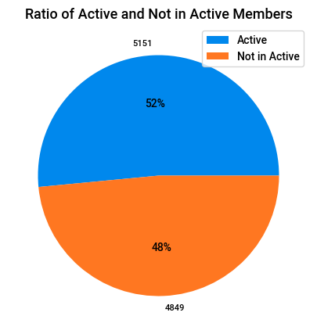
1.Ratio of Attrited and Existing Customers
Ratio of Active and not inactive Customers
Existing Customers : 80% - 7963
Attrited Customers : 20% - 2037
Active are : 52%- 5151
Not in active are : 4% - 4849

Slide 4
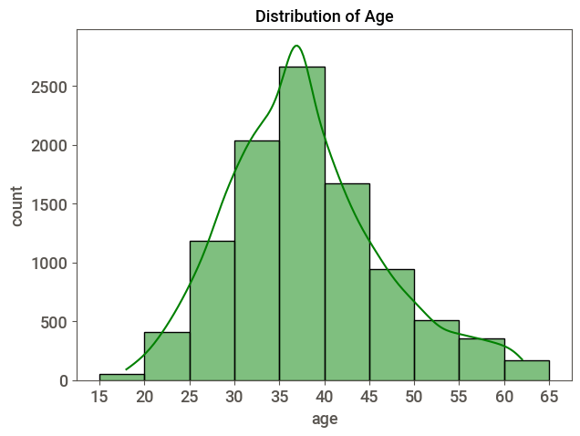
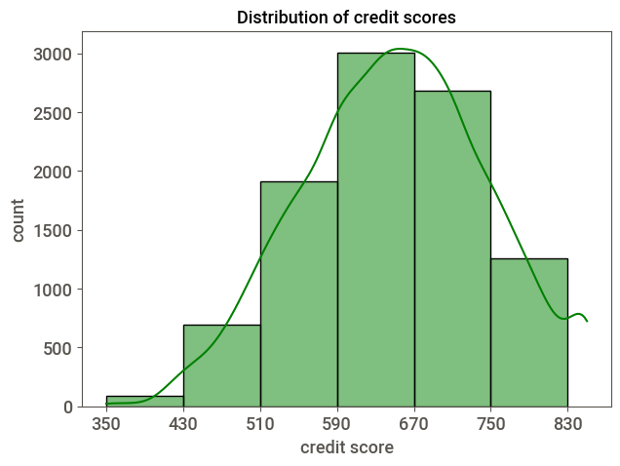
Distribution of Age
Distribution of Credit Score
Customers aged 30 to 40 years are more
Credit score is more between 590-750

Slide 5
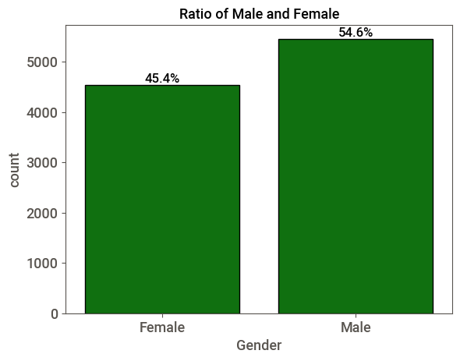
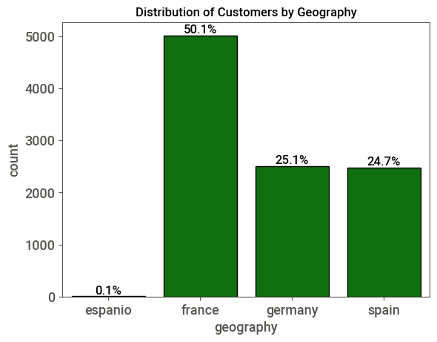
Ratio of Male and Female
Distribution of Customers by Geography
Male are : 54%
Female are : 45.4%
France customers are more : 50.1%

Slide 6
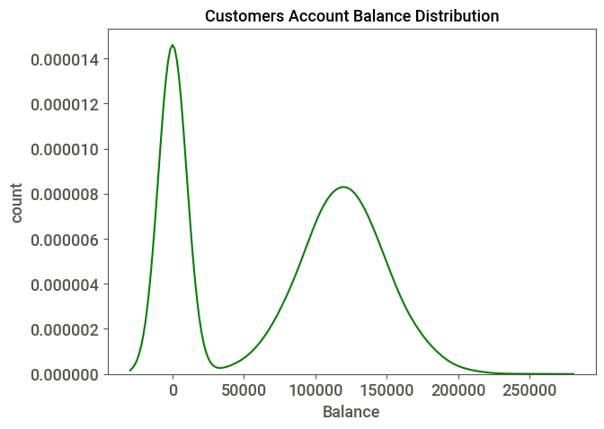
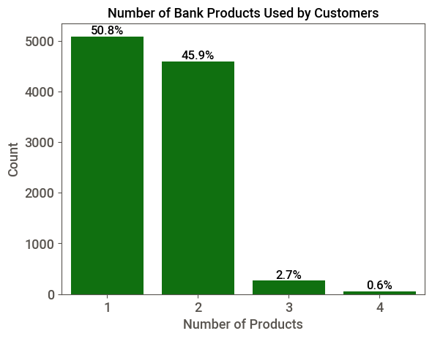
Customers Account Balance Distribution
Number of products used by Customers
Customers are more who are not having bank balance
Bank product :1 – 50.%
Bank product : 2-45.9%

Slide 7
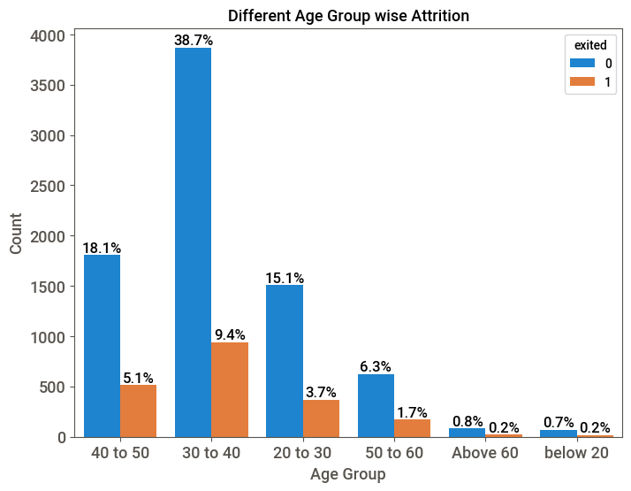
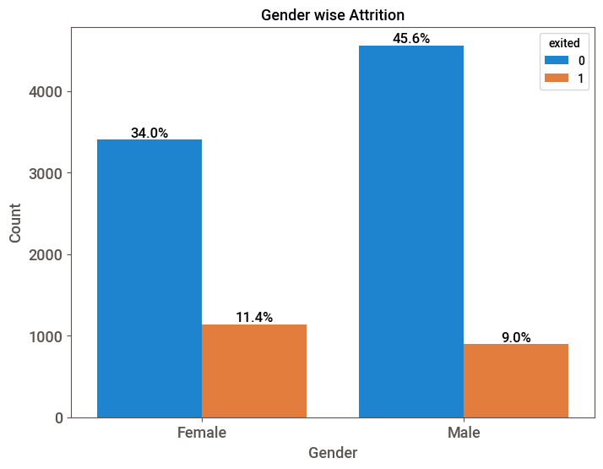
Different Age group wise attrition
Gender wise Attrition
Customers aged between 30-40 are leaving more:9.4%
Females are leaving more : 11.4%

Slide 8
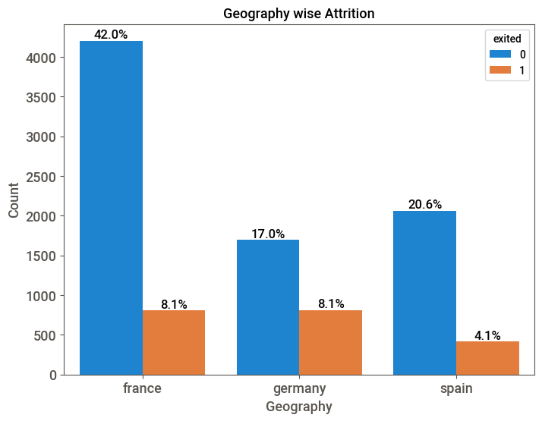
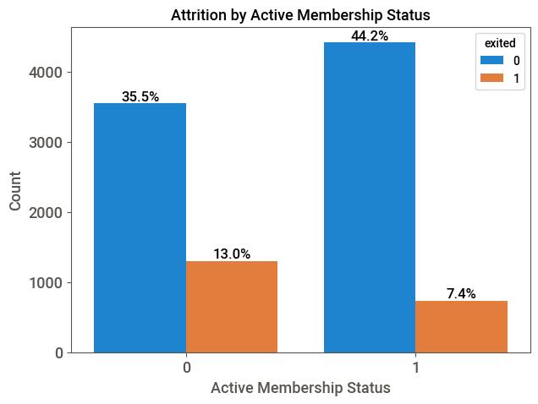
Geography wise Attrition
Attrition by Active Customers Status
France customers and Germany customers are leaving more : 8.1%
Customers who are active they are leaving more : 13%

Slide 9
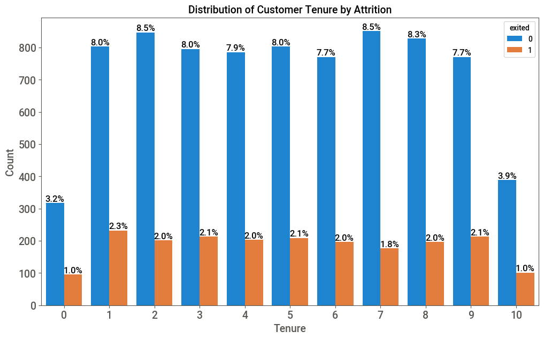
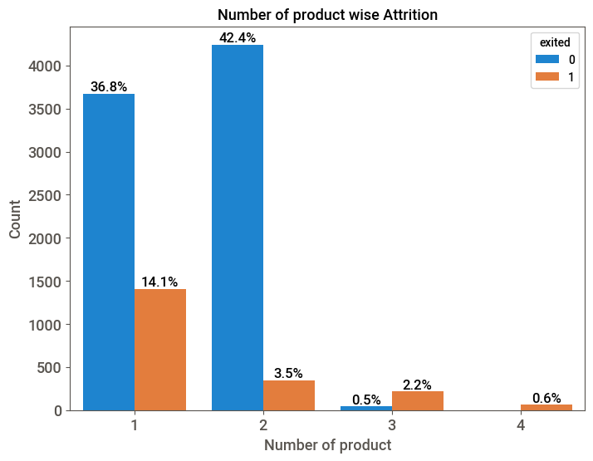
Distribution of customers Tenure by Attrition
Number of product wise Attrition
all customers who've been with the bank for different Tenure of time are leaving at about the same rate
Customers who are using 1 bank product they are leaving more

Slide 10
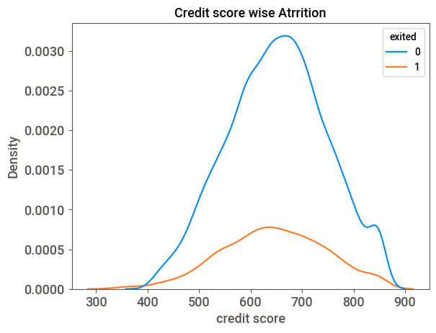
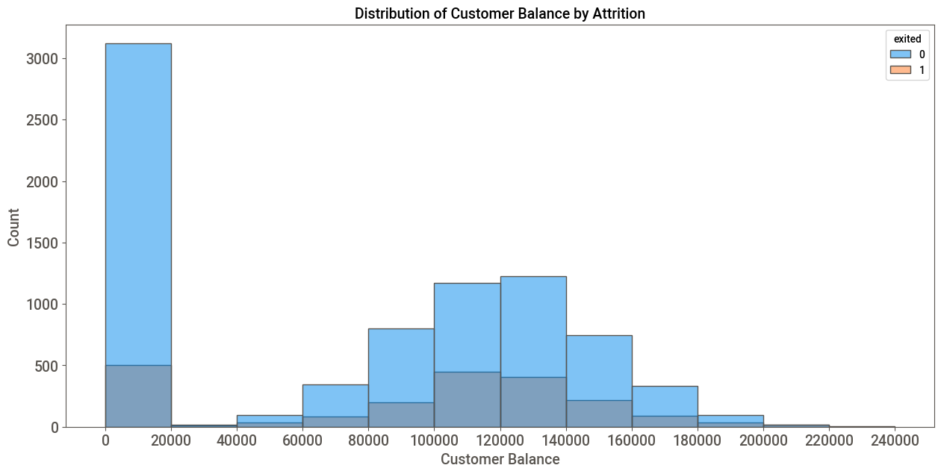
Credit Score wise Attrition
customers Balance by Attrition
Customers with credit score between 550-750 are leaving more
People with zero balance and with 80k to 160k are leaving more.

Slide 11
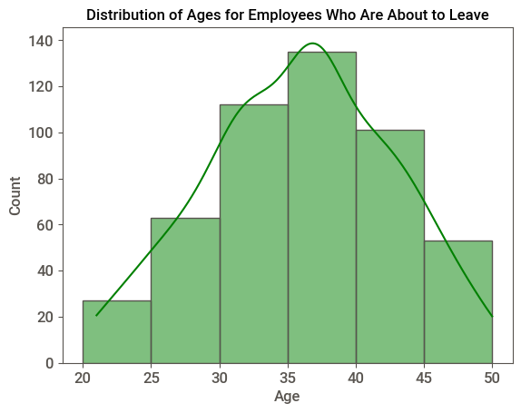
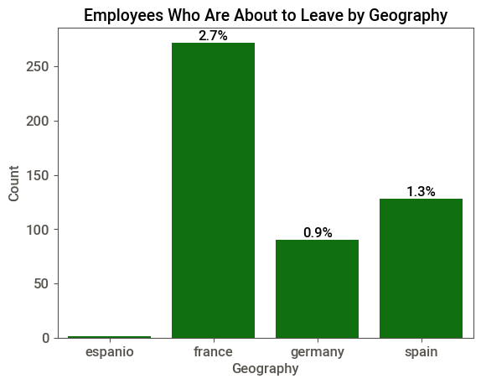
Distribution of Ages for Employees who are about to leave
Employees who are about to leave by Geography
Customers aged 30-45 are about to leave
France customers are about to leave more : 2.7%

Slide 12
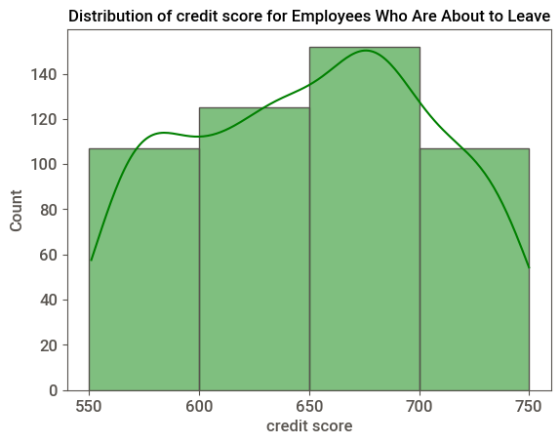
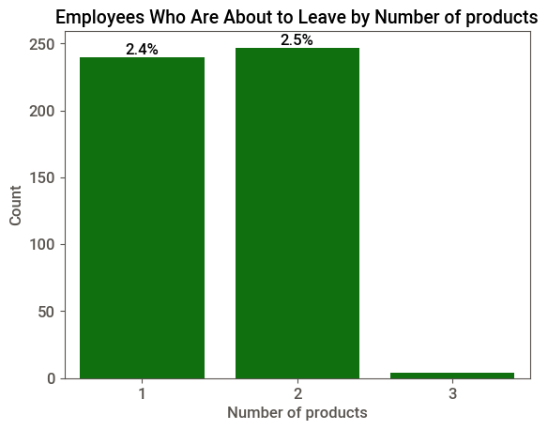
Distribution of credit score for Employees who are about to leave
Employees whoa are about to leave by number of products
Customers with credit score 650-700 are about to leave more
Customers who are using 1 product of the bank are about to leave 2.4%

Slide 13
ALGORITHMS
M A C H I N E L E A R N I N G
Algorithms Logistic Regression Bagging Method Random Forest Stacking Base models: DecisionTree, Support Vector Classification Naïve Bayes Meta Model : Logistic regression | Performance Training:80.75% r^2 Testing : 27. f1_score Training : 84.55%. cv score Testing : 85.55. oob score Training : 84.11%.cv score | Conclusion Overfitting problem occurred Reduced overfitting. Good Performance Giving the performance same as Random Forest

Slide 14
Customer Details:
30 – 40 years aged customers are more
Existing Customers : 80% - 7963
Attrited Customers : 20% - 2037
Male are : 54%
Female are : 45.4%
France customers are more : 50.1%
Active customers are : 52%- 5151
Not in customers active are : 4% - 4849
Customer Attrition analysis:
Customers aged between 30-40 are leaving more:9.4%
Females are leaving more : 11.4%
France customers and Germany customers are leaving more : 8.1%
Customers who are using 1 bank product they are leaving more
Customers with credit score between 550-750 are leaving more
People with zero balance and with 80k to 160k are leaving more.
Customers About to leave:
Customers aged 30-45 are about to leave
France customers are about to leave more : 2.7%
Customers with credit score 650-700 are about to leave more
Customers who are using 1 product of the bank are about to leave 2.4%
SUMMARY
Provide personalized incentives and offers to customers in the 30-40 age group customers, as they are more likely to leave.
Give special deals to females because female customers are about to leave more
Launch special campaigns to keep customers from France and Germany.
Provide additional services to customers who exclusively use one of our products . so they start using our more products
Put up ads to get more people interested in what we have.

Slide 15


